Slide 1
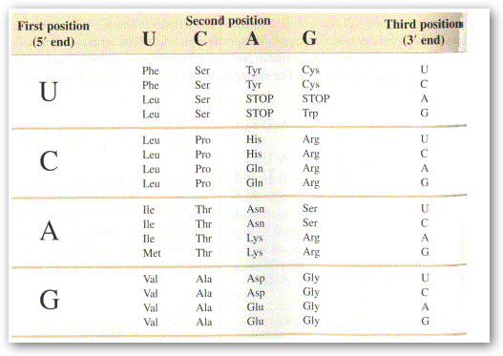

Slide 2
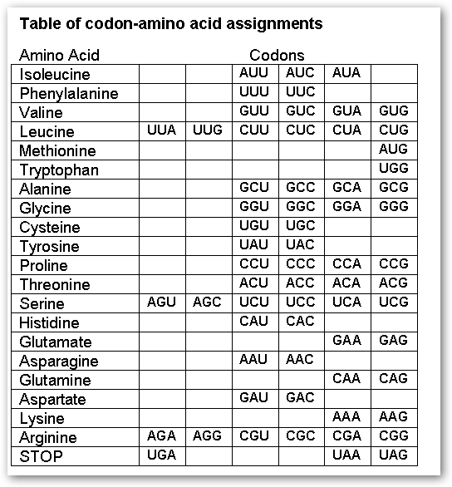

Slide 3
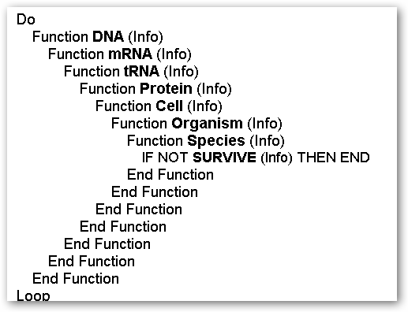

Slide 4
CCAGUUUCAGGGAGUUUAGGUAGCGCAGUGUUUUUCCAUUUCGCAGCCGUCCAGUUUCAGGGAGUUUAGGUAGCGCAGUGUUUUUCCAUUUCGCAGCCGU

Slide 5
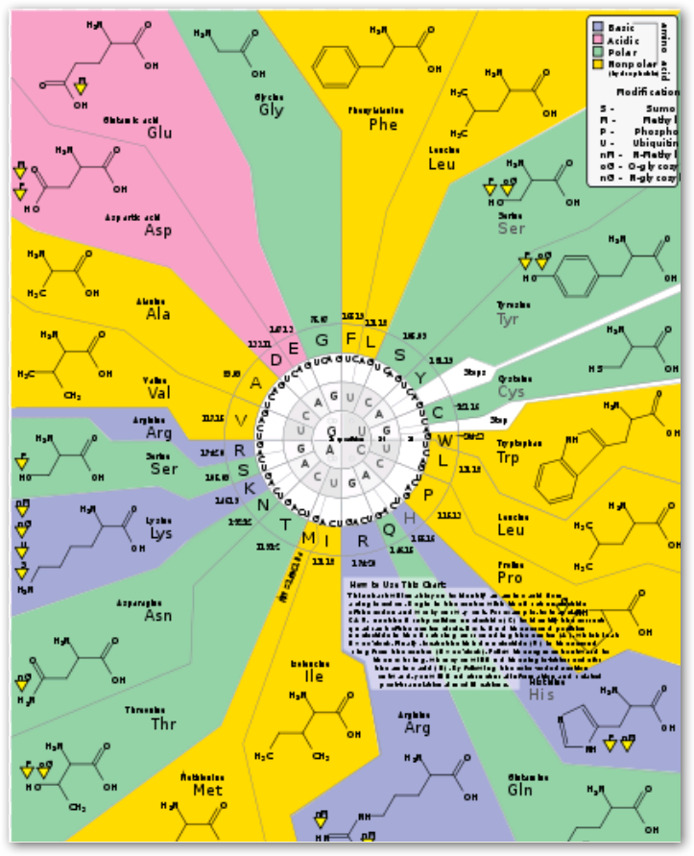

Slide 6
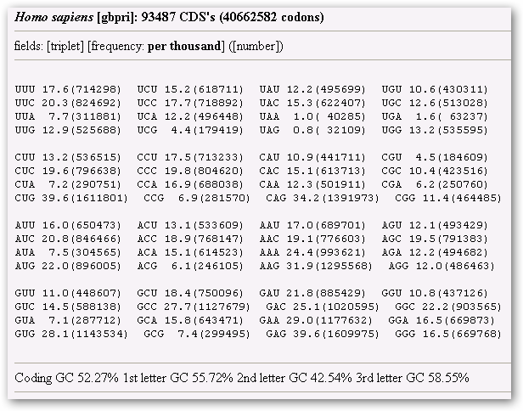

Slide 7

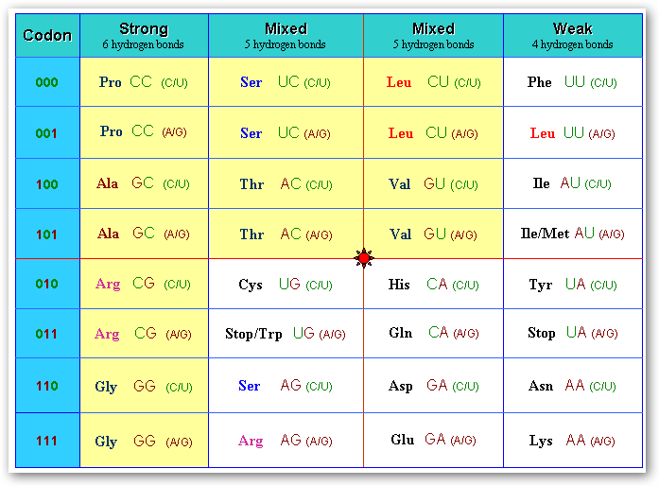

Slide 8
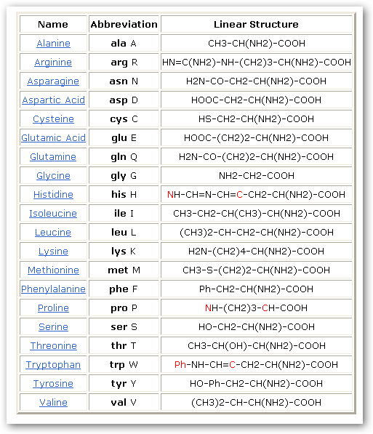

Slide 9
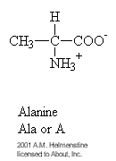
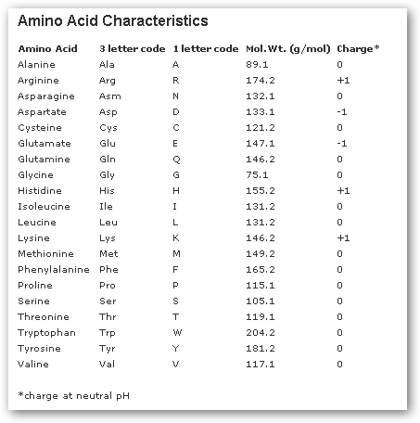

Slide 10
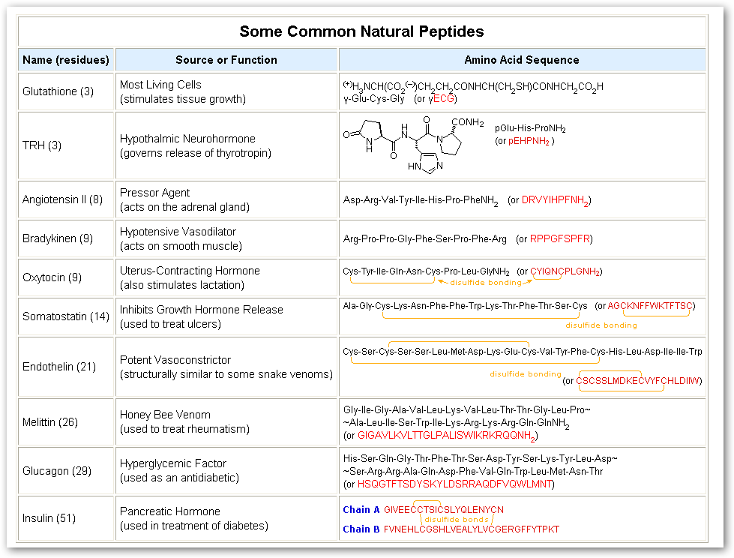

Slide 11
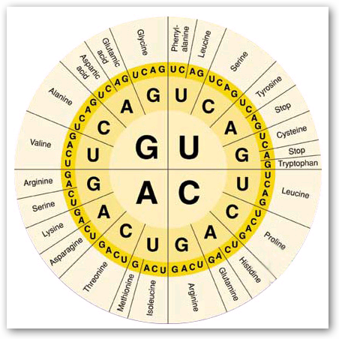

Slide 12
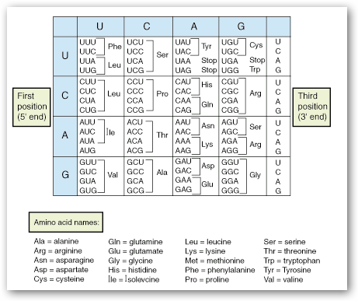

Slide 13
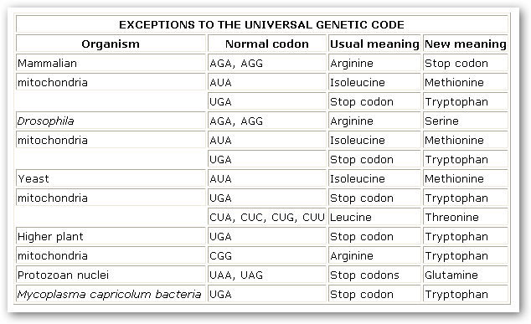

Slide 14
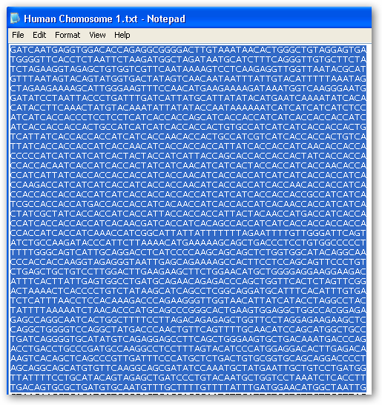

Slide 15
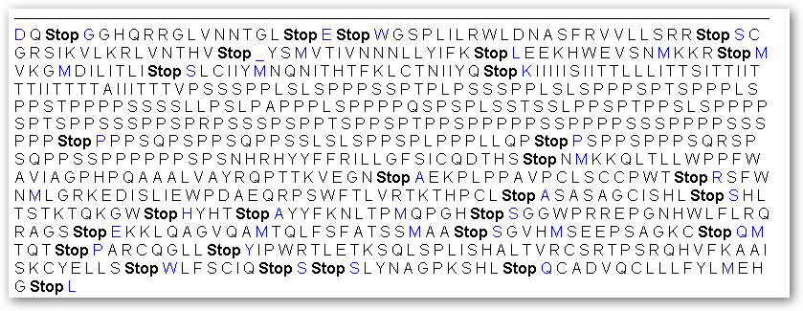

Slide 16
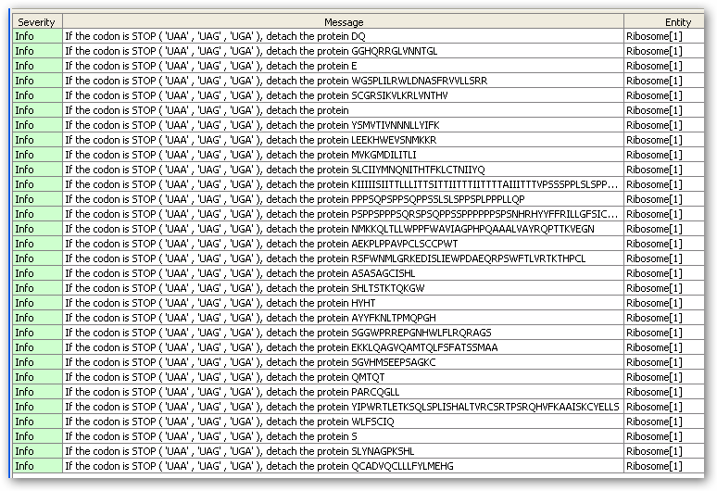

Slide 17
Sequence manipulation site
  http://www.bioinformatics.org/sms2/codon_plot.html

Slide 18
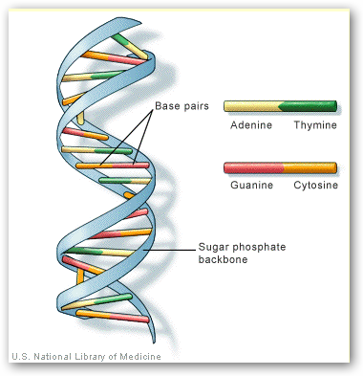

Slide 19
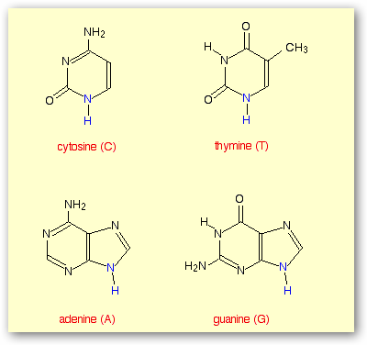

Slide 20
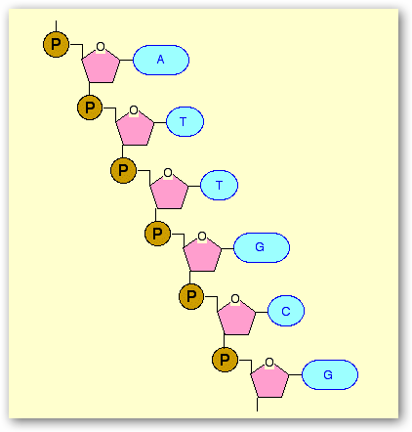

Slide 21
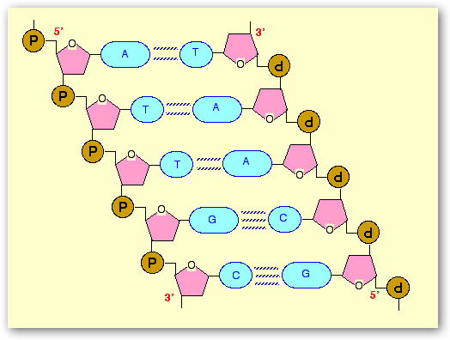

Slide 22
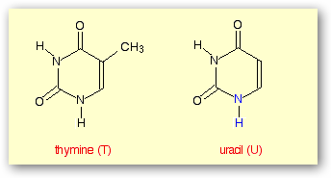

Slide 23
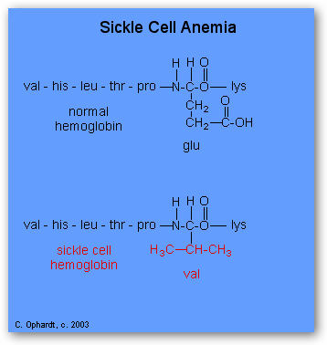
Sickle Cell Anemia:
The incorrect amino acid sequence in a protein may lead to fatal consequences. For example, the inherited disease, sickle cell anemia, results from a single incorrect amino acid at the 6th position of the beta - protein chain out of 146. Hemoglobin consists of four protein chains - two beta and two alpha.
See the graphic on the left for the sequences. This one alteration of the sequence of amino acids in hemoglobin changes its molecular geometry and hence its ability to carry oxygen and its solubility characteristics. The red blood cells change into a sickled shape instead of the normal round shape, become trapped in the small blood capillaries, and cause a great deal of pain.

Slide 24
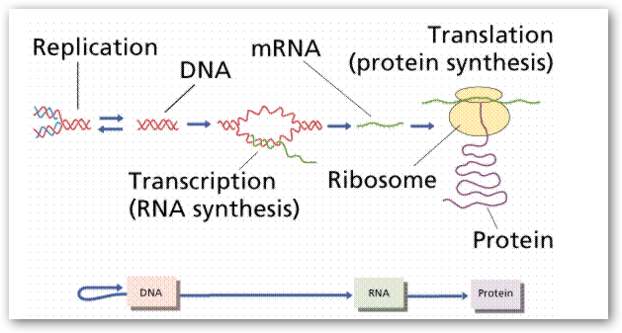

Slide 25
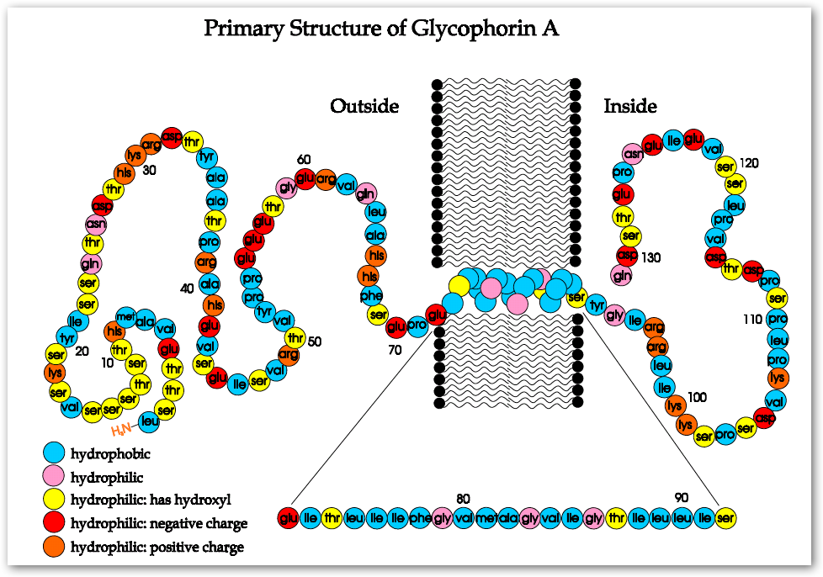

Slide 26
Biological Process
GO:0006289:nucleotide-excision repair [PMID:7663514; evidence:IMP]
GO:0044419:interspecies interaction between organisms [SPKW; evidence:IEA]
GO:0008104:protein localization [PMID:16507995; evidence:IDA]
GO:0000122:negative regulation of transcription from RNA polymerase II promoter [compara evidence:IEA]
GO:0043525:positive regulation of neuron apoptosis [compara evidence:IEA]
GO:0007569:cell aging [PMID:12080348; evidence:IMP]
GO:0001701:in utero embryonic development [compara evidence:IEA]
GO:0007417:central nervous system development [compara evidence:IEA]
GO:0002347:response to tumor cell [INTERPRO; evidence:IEA]
GO:0030330:DNA damage response, signal transduction by p53 class mediator [PMID:11672523; evidence:TAS]
GO::
Cellular Component
GO:0005626:insoluble fraction [PMID:12915590; evidence:IDA]
GO:0005737:cytoplasm [compara evidence:IEA][SPKW evidence:IEA][SPSL evidence:IEA][PMID:14744935 evidence:IDA][PMID:7720704 evidence:IDA]
GO:0016605:PML body [PMID:12006491; evidence:IDA]
GO:0005654:nucleoplasm [PMID:11080164; evidence:IDA][PMID:12915590; evidence:IDA]
GO:0005730:nucleolus [PMID:12080348; evidence:IDA]
GO:0005739:mitochondrion [PMID:12667443; evidence:IDA]
GO:0005829:cytosol [compara evidence:IEA]
GO:0016363:nuclear matrix [PMID:11080164; evidence:IDA]
GO:0005783:endoplasmic reticulum [SPKW; evidence:IEA][SPSL; evidence:IEA]
GO:0005657:replication fork [compara evidence:IEA]
GO::

Slide 27
5.1.4 HBonds
The `HBonds' representation will draw a dotted line between two atoms if there is a possible
hydrogen bond between them. A possible hydrogen bond is dened by the following criteria:
Given an atom D with a hydrogen H bonded to it and an atom
A which is not bonded to D, a hydrogen bond exists between
A and H iff the distance ||D-A|| < dist and the angle D-H-A < ang,
where ang and dist are user defined.
Only the selected atoms are searched, so both the donor and acceptor must be selected for the
bond to be drawn. Also, you'll note that the above doesn't check the atom type of the donor or
acceptor; the only criterion is if it already has or doesn't have a hydrogen.
One downfall of the current implementation is that it does an n2 search of the selected atoms
so you probably don't want to show all the HBonds of a very large structure. Look for performance
improvements in future versions of VMD.
If you choose an HBonds representation but fail to see any hydrogen bonds, it may be because
the default Angle Cuto and Distance Cuto criterion in VMD are too small, so you might want to
try increasing the angle value from 20 to 30 degrees and the distance value from 3 to 4.
The HBonds are drawn as dotted lines of a given width. The default Line Thickness is 1 but
you should probably increase that to 2. On most SGIs you can't make it any wider than that,
as described in the man page for linewidth. The bond is colored by the color associated with the
acceptor.

